Slide 1
An approach to preventing, correlating, and predicting multi-step Network Attacks
Sharada Valiveti

Slide 2
Contents
Introduction
Related work
Preliminaries
Hardening network to prevent multi-step intrusions
Correlating and predicting multi-step attacks
Conclusions

Slide 3
Introduction
Skilled attacks employ multiple attacks
Evade security measures
Infiltrate seemingly well guarded network
IDSs can report isolated vulnerabilities and attacks – impractical
Attack graph
Topological Vulnerability Analysis
Focus on capturing interdependency between vulnerabilities

Slide 4
Related Work
Aim of alert correlation techniques
Hybrid approaches combine different techniques for better results
Useful for relating alerts to same thread of attacks
Used to deal with insider attacks
Tools are available for scanning network vulnerabilities
Attack graphs are constructed by analyzing inter-dependency between vulnerabilities and security conditions that have been identified in the target network
Forward starting or backward starting
Compact representation of attack graph
Minimal critical attack set

Slide 5
Preliminaries
Attack graph
Represent prior knowledge about network connectivity and dependency between vulnerabilities
2 representations
Explicitly enumerate all possible sequences of vulnerabilities that an attacker can follow
Dependency relationships among vulnerabilities and attack paths are encoded implicitly
Represented as a directed graph with two types of vertices – exploits and security conditions
Exploit as tuple (v, h_{s}, h_{m}, h_{d})
Security condition is a triple (c, h_{s}, h_{d})
Two types of directed edges inter-connect exploits and conditions
Condition to exploit – require relation
Exploit to condition – imply relation

Slide 6
Preliminaries
Attack Graphs
Given a set of Exploits E, a set of conditions C, a require relation and imply relation
We call the directed graph G(E U C, R_{r} U R_{i}) an attack graph (E U C) is the vertex set and R_{r} U R_{i} the edge set
We use -> for the prepare-for relation R_{i} ◦ R_{r} (◦ denotes the composition)
Vertices denote security conditions (Plain text)
Ovals denote exploits

Slide 7
(h1,sadmind_service)
(h3,sadmind_service)
(h2,h1,sadmind_bof)
(h3,h1,sadmind_bof)
(h1,user_priviledge)
(h3,h1,sadmind_service)
(h1,h2,sadmind_bof)
(h3,h2,sadmind_bof)
(h2,user_priviledge)
An example of Attack Graph

Slide 8
Preliminaries
Attack Graphs
Require relation is always conjunctive while imply relation is always disjunctive
Exploit cannot be realized until all of its required conditions have been satisfied
A condition is satisfied if any of the realized exploits implies the condition
Disjunction
Collection of exploits may jointly imply a condition
Conjunction

Slide 9
Preliminaries
Intrusion Alert and Correlation
Adopt vulnerability – centric – correlation approach
Matches alerts (event type attributes) with exploits (vulnerability type attributes) and then correlate them using the knowledge encoded in an attack graph
Can mitigate negative impact of disruptive alerts
Correlation methods depend on Temporal characteristics of alerts
Uncertain

Slide 10
Hardening Network to Prevent Multi-Step Intrusions
Hardening the network
Removing vulnerabilities
Modifying network configurations
Incurs cost that should be optimal
Optimal solution should provably prevent any attacker from reaching a given goal and yet incur the lowest cost

Slide 11
(ftp_1,0)
(user,0)
(ftp_2,0)
(ftp_rhosts,0,1)
(ftp_rhosts,0,2)
Trust(0,1)
(trust_0,2)
(rsh,0,2)
(rsh,0,1)
(ftp_1,2)
(user,2)
(ftp_rhosts,2,1)
(Local_bof,2,2)
(trust_2,1)
(sshd_1,0)
(sshd_1,2)
(rsh,2,1)
(sshd_bof,0,1)
(sshd_bof,2,1)
(ftp_2,1)
(user,1)
(ftp_rhosts,2,1)
(Local_bof,2,2)
(Root,2)
(root,1)
(trust_1,2)
(rsh,1,2)

Slide 12
Hardening Network to Prevent Multi-Step Intrusions
Valid attack paths generated:
(ftp_rhosts,0,2),(rsh,0,2),(local_bof,2)
(ftp_rhosts,0,1),(rsh,0,1),(ftp_rhosts,1,2),(local_bof,2)
(sshd_bof,0,1),(ftp_rhosts,1,2),(rsh,1,2),(local_bof,2)
Break all attack paths leading to the goal
Concept of minimal critical set
Not all exploits are under direct control of administrators
Intermediate conditions cannot be independently disabled without removing the exploits that imply them

Slide 13
Hardening Network to Prevent Multi-Step Intrusions
In an attack graph G(EUC, R_{r}UR_{i}), initial conditions refer to subset of conditions C_{i}={c|there does not exist eϵE such that (e, c) ϵ Ri}, whereas intermediate conditions refer to complement C-C_{i}
Theoretically sound solutions cannot be practically enforceable

Slide 14
Hardening Network to Prevent Multi-Step Intrusions
A graph based algorithm for Hardening Networks
Which of the initial conditions are to be disabled, if goal conditions are never to be satisfied?
Each exploit or condition is interpreted by logic variable and relation by Logic Propositions
Hence network hardening problem is simply to find value assignments to the initial conditions satisfying that a given set of goal conditions are all false

Slide 15
Hardening Network to Prevent Multi-Step Intrusions
A graph based algorithm for Hardening Networks
Given an attack graph G(EUC, R_{r} U R_{i}) and the goal condition C_{g} is subset or equal to C, let P(G) denote a logic program comprised of following clause for each eϵE:
e←c₁∩c₂∩…c_{n}
c₁,c₂,…c_{n}ϵR_{r}(e)
Collection of clauses for each cϵC:
c←e₁, c←e₂,… c←e_{m}, e₁, e₂,…,e_{m}ϵR_{i}(c)
Network hardening problem is to satisfy goal c₁’∩c₂’ ∩…c_{n}’ where c₁, c₂, …, c_{l}ϵC_{g}

Slide 16
Hardening Network to Prevent Multi-Step Intrusions
Clauses:
ftp_rhosts(0,1)← ftp(0,1)∩user(0)
rsh(0,1) ←trust(1,0)∩user(0)
User(1) ←rsh(0,1) V rsh(2,1) V sshd_bof(0,1) V sshd_bof(2,1)
root(2) ←local_bof(2)
To harden the network, the goal is root(2)’ is true

Slide 17
Hardening Network to Prevent Multi-Step Intrusions
Procedure Network_Hardening
Input: An attack graph G(EUC, R_{r} U R_{i} ) and the goal conditions C_{g} is subset or equal to C
Output: A solution L to the goal ∩_{cϵcg} c’

Slide 18
Method:
Let L= ∩_{cϵcg} c’ //The initial goal
For each eϵE and cϵC
Let Pre(e)={e} and Pre(c)={c} //Initialize predecessor list
Do a breadth-first search in G starting from C_{g}
For each encountered condition c //Each exploit e is //handled similarly
Let S_{e}={e₁,e₂,…,e_{n}} be the exploits pointing to c in G
Let T=(e₁ V e₂ V …e_{n}) //Temporary variable
For each e_{i} ϵ S_{e}∩ Pre(c)
Replace e_{i} with FALSE in T
Replace c with T in L
For each e_{i}ϵS_{e} – Pre(c)
Let Pre(e_{i})=Pre(e_{i})U Pre(c) //Update predecessor List
4. Return L

Slide 19
(ftp_1,0)
(ftp_2,0)
(ftp_rhosts,0,1)
(ftp_rhosts,0,2)
Trust(0,1)
(trust_0,2)
(rsh,0,2)
(rsh,0,1)
(user,2)
(Local_bof,2,2)
(sshd_1,0)
(sshd_bof,0,1)
(sshd_bof,2,1)
(ftp_2,1)
(user,1)
(ftp_rhosts,2,1)
(Local_bof,2,2)
(Root,2)
(trust_1,2)
(rsh,1,2)

Slide 20
Hardening Network to Prevent Multi-Step Intrusions
L = not(root(2))
=not(rsh(0,2) V rsh(1,2))
=not(ftp_rhosts(0,2) V trust (2,1) ∩ user(1)
=not(ftp(0,2) V ftp(1,2) ∩ (rsh(0,1) V sshd_bof(0,1) V rsh(2,1) V sshd_bof(2,1)))
=not(ftp(0,2) V ftp(1,2) ∩ (ftp(0,1) V sshd(0,1) V trust(1,2) ∩ false V sshd(2,1) ∩ FALSE))
=not(ftp(0,2) V ftp(1,2) ∩ (ftp(0,1) V sshd(0,1)))

Slide 21
Hardening Network to Prevent Multi-Step Intrusions
Minimum – Cost Solutions
Network hardening returns multiple options
Convert proposition L to its disjunctive normal form (DNF)
Each disjunction represents sufficient option in hardening
Each disjunction is conjunction of negated initial conditions
Hence

Slide 22
Hardening Network to Prevent Multi-Step Intrusions
L=not(ftp(0,2) V ftp(1,2) ∩ (ftp(0,1) V sshd(0,1)))
= not((ftp(0,2) V ftp(1,2)) ∩ (ftp(0,2) V ftp(0,1) V sshd(0,1)))
= not(ftp(0,2)) ∩ not(ftp(1,2)) V not (ftp(0,1)) ∩ not(sshd(0,1))
Hence disable
ftp(0,2) and ftp(1,2)
ftp(0,2), ftp(0,1) and sshd(0,1)

Slide 23
Hardening Network to Prevent Multi-Step Intrusions
Minimum Cost Solutions
Theoretically, DNF of L may have an exponential size in number of initial conditions
Options that incur minimum cost can be easily chosen, if cost of disabling each initial condition ahs been assigned by administrators
Cost of an option is equal to summation of cost of all initial conditions involved by the option
Here, first option has lower cost than the second one

Slide 24
Correlating and Predicting Multi-Step Attacks
Monitoring and predicting progress in real time
Motivation
Nested loop approach
Can be defeated by slow attacks
Can place bogus attacks between two correlated attacks
time
time
a₀ a₁ … a_{i-1} a_{i} … a_{n} a₀ a₁ … a_{i-k} … a_{i-1} a_{i} … a_{n}
k
search
search
Nested Loop Approach without Sliding Window
Nested Loop Approach with Sliding Window

Slide 25
Correlating and Predicting Multi-Step Attacks
Queue Graph based Alert correlation
Remove limitation of nested loop approach
New alert only needs to be explicitly correlated with last alert matching each exploit
Exp(a_{i})=Exp(a_{j})=Exp(a_{k})
Exp(a_{k})→Exp(a_{h})
time
… a_{i} … a_{j} … a_{k} … a_{h} …
Implicit and Explicit Correlation

Slide 26
Correlating and Predicting Multi-Step Attacks
Queue Graph based Alert correlation
Observation:
Keeping correlations implicit can significantly reduce complexity and Memory requirement
Correlation is always explicit
Hence design in-memory data structure called Queue Graph
Each exploit is realized as queue and each condition as variable
BFS is performed on Attack Graph by following directed edges
Forward (prediction) and backward (correlation purpose) pointers are created

Slide 27
Correlating and Predicting Multi-Step Attacks
Queue Graph based Alert correlation
Pointers are placed at separate layer tailored to queue corresponding to exploit e_{i}
A BFS creates a tree
Another BFS starting from same queue can follow only the pointers at that layer
Searching in a queue is linear instead of quadratic

Slide 28
Correlating and Predicting Multi-Step Attacks
Queue Graph based Alert Correlation
BFSR (k): set of edges visited by BFS starting from e_{k} in G(E U C, R_{r} U R_{i})
BFS(k) for set of edges visited by BFS starting from e_{k} in G(E U C, R⁻¹_{r} U R⁻¹_{i})
Queue Graph Q_{g} is a data structure with following:
Q = {Q_{i} | 1≤ i ≤ n} are n queues of length one,
V = {v_{i} | 1≤ i ≤ m} are m variables,
For each k=1,2,…n,
P_{k} = {<Q_{j},v_{i}> | (c_{i},e_{j}) ϵ BFS(k)} U {<v_{i},Q_{j}> | (e_{j},c_{i})ϵBFS(k)} are the layer k backward pointers, and
PR_{k} = {<v_{i},Q_{j}> | (c_{i},e_{j})ϵBFSR(k)} U {<Q_{j},v_{i}> | (e_{j},c_{i})ϵBFSR(k)} are the layer k forward pointers

Slide 29
Attack Graph
Queues, Variables
Layer 1 Pointers
Layer 2 Pointers
Layer 3 Pointers
c₂
v₂
v₂
v₂
v₂
Q₂
Q₃
Q₂
Q₃
Q₂
Q₃
e₂
e₃
v₁
v₁
v₁
v₁
Q₁
Q₁
Q₁
Q₁
c₁
e₁
An example of Queue Graph

Slide 30
Correlating and Predicting Multi-Step Attacks
Queue Graph based Alert correlation
Q = {Q₁, Q₂, Q₃}
V = {v₁, v₂}
PR₁ = Φ
P₁ = {<Q₁,v₁>,<v₁,Q₂>,<Q₂,v₂>,<v₁,Q₃>}
P₂ = {<Q₂,v₂>}
PR₂ = {<Q₂,v₁>,<v₁,Q₁>}
P₃ = {<Q₃,v₂>}
PR₃ = {<Q₃,v₁>,<v₁,Q₁>}

Slide 31
Correlating and Predicting Multi-Step Attacks
Queue Graph based Alert correlation
Let stream of alerts flow through queue graph
Each incoming alert is first matched with an exploit and placed in corresponding queue
Since length of each queue is one, a non-empty queue must dequeue the current alert before it can enqueue a new alert
Results of correlation are collected as DAG – result graph

Slide 32
Correlating and Predicting Multi-Step Attacks
Queue Graph based Alert correlation
Each new alert is recorded as a vertex in result graph
When a new alert forces an old alert to be dequeued, directed edge between two alerts is added in result graph
After each new alert is enqueued, a search starts from queue and follows two consecutive backward pointers
DQ_Alert_Correlation procedure

Slide 33
Correlating and Predicting Multi-Step Attacks
Queue Graph based Alert correlation
Procedure DQ_Alert_Correlation
Input A queue graph Q_{g} with n queues and m variables, the initial result graph G_{r}(V,E_{r} U E_{l} ), and an alert a_{new} satisfying Exp(a_{new}) = e_{i} (1 ≤ i ≤ n)
Output: The updated result graph G_{r}(V,E_{r} U E_{l})
Method:
Insert a_{new} into V
If Q_{i} contains an alert a_{old}
Insert edge (a_{old},a_{new}) into E_{l}
Dequeue a_{old} from Q_{i}
Enqueue a_{new} into Q_{i}
For each Q_{j} (1 ≤ j ≤ n) satisfying <Q_{i},v_{k}> ϵ P i ∩ <v_{k}, Q_{j}> ϵ P_{i} (1 ≤ k ≤ m)
If Q_{j} contains an alert a_{j}
Insert (a_{j}, a_{new}) into E_{r}
Return G_{r}(V, E_{r} U E_{l})

Slide 34
Correlating and Predicting Multi-Step Attacks
Queue Graph based Alert correlation Advantages
Search is linear
Performance of QG is independent of number of received alerts
Memory usage of QG is roughly O(n(n+m)) due to n layers of maximally (n+m) pointers
QG approach is not vulnerable to slowed attacks
When an alert is dequeued, it will no longer be needed for correlation
Use conservative approach in correlating alerts
Concurrent and non-concurrent alerts
Enables us to tolerate varying delays in a network and small differences between clocks of sensors

Slide 35
Correlating and Predicting Multi-Step Attacks
Queue Graph based Alert correlation
Time factors
T_{con} refers to Concurrency threshold
T_{max} refers to varying delay bounded
Time window is used for reordering alerts
No alert will be excluded from correlation
Correlation will no longer be vulnerable to slow attacks

Slide 36
Correlating and Predicting Multi-Step Attacks
Hypothesizing Missing Alerts and Predicting Future Alerts
Missing alerts cause inconsistency between knowledge encoded in attack graphs and fact represented by received alerts
By extending facts in consistent way with respect to knowledge, possible consequences of an intrusion can be predicted

Slide 37
Correlating and Predicting Multi-Step Attacks
Hypothesizing Missing Alerts and Predicting Future Alerts
We say an exploit is ready to be executed if all of its required intermediate conditions are satisfied by previous executions of exploits.
Sequence of alerts is consistent, if every alert in sequence matches an exploit ready to be executed by the time the alert is received

Slide 38
time
a₀ a₁ a₃
a₀
a₀
a₀
e₀
e₀
e₀
c₁
c₂
c₁
c₂
c₁
c₂
a₁
e₁
e₂
e₁
e₂
e₁
e₂
a₁
c₃
c₃
c₃
c₄
a₃
e₃
a₃
e₃
a₃
e₃
Inconsistent
Consistent
Inconsistent
Extend correlation method to hypothesize missing alerts
Need to explain occurrence of a new alert by including it in a consistent sequence of alerts (by alert correlation) and missing alerts (by alert hypothesis)

Slide 39
Correlating and Predicting Multi-Step Attacks
Hypothesizing Missing Alerts and Predicting Future Alerts
Modifications in QG Procedure:
Each variable in V can have TRUE (satisfied condition), FALSE (unsatisfied condition) and HYP(hypothetically satisfied) with timestamp
Each missing alert is substituted by HYP indicating that this particular Queue has been accessed through BFS
Prediction begins at the conditions satisfied by new alert and makes partial BFS in queue garph by following pointers in PR_{i}
Search stops at previously received alerts and their satisfied conditions to avoid repeating previous prediction
Output of Prediction is sequence of non-empty sets Con₁, Con₂, …, Con_{i}
These conditions are not disjunctive or conjunctive in nature

Slide 40
Correlating and Predicting Multi-Step Attacks
Compressing Graph Results
Reduces size of result graphs by having less transitive edges
Usually, brute force attacks with different parameters lead to large number of alerts
Exp(a_{i})=Exp(a_{j}), Exp(b_{i})=Exp(b_{j}), Exp(c_{i})=Exp(c_{j}) for 1≤i, j ≤4
Exp(a_{i})→Exp(b_{i}) and Exp(c_{i})→Exp(b_{i})
time
time
a₁ a₂ a₃ a₄
a₁ a₂ a₃ a₄
c
c
b₁ b₂ b₃ … b₄
b₁, b₂, b₃ …, b₄

Slide 41
Correlating and Predicting Multi-Step Attacks
Empirical Results
Correlation Engine capable of processing alerts with negligible delays

Slide 42
Correlating and Predicting Multi-Step Attacks
Effectiveness
The Result Graph gets extended
Hypothesis of Missing Alerts during Correlation
Prediction of Possible Consequences

Slide 43
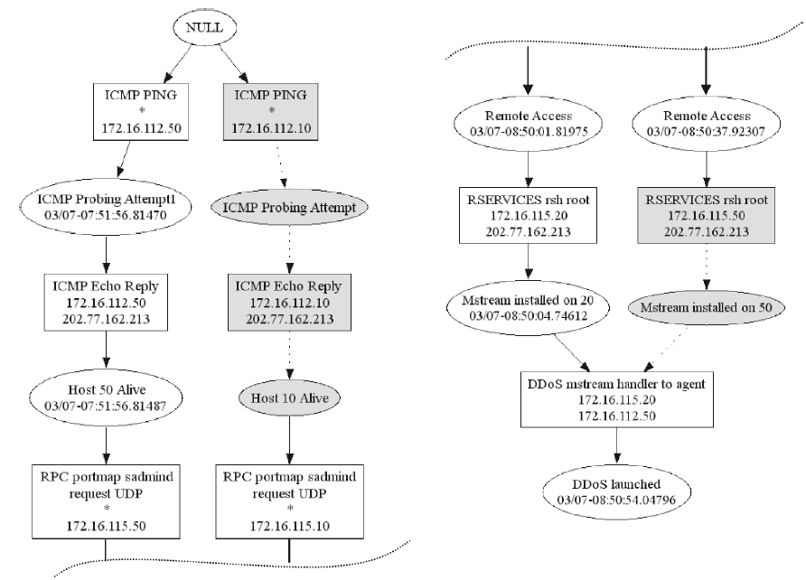

Slide 44
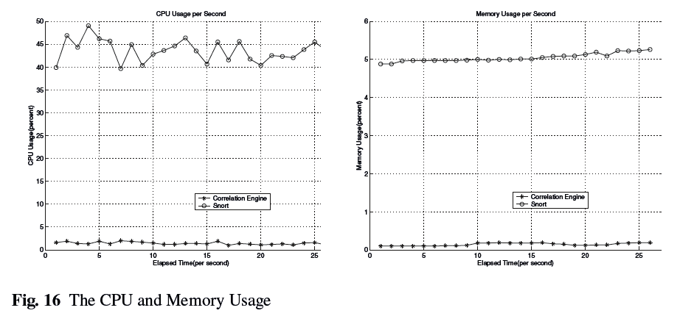
Correlating and Predicting Multi-Step Attacks
Conclusions

Slide 45
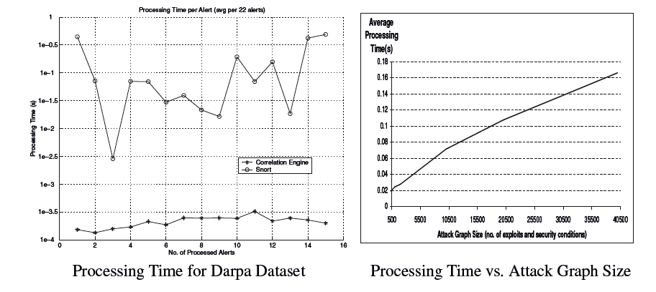
Correlating and Predicting Multi-Step Attacks
Conclusions

Slide 46
Thank you

